Slide 1
Meet 10/16
106061531 王福恩

Slide 2
Paper Reading
DeepVO
SE3-Nets
SfM-Net (Review)
LSD-SLAM
Semi-dense visual odometry for a monocular camera (still reading)
CNN-SLAM

Slide 3
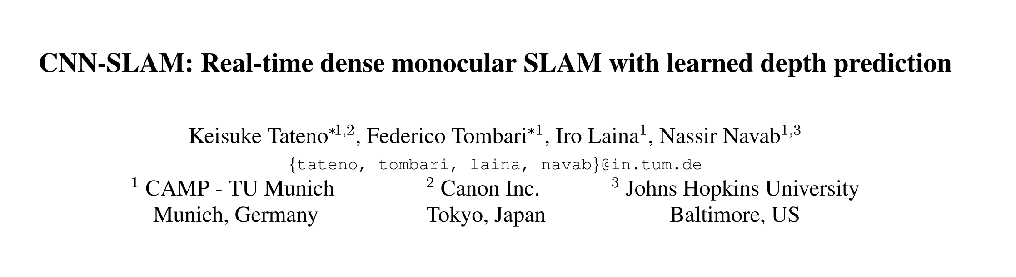
CVPR 2017 Spotlight

Slide 4
Overview
Single View Depth Estimate + LSD-SLAM

Slide 5
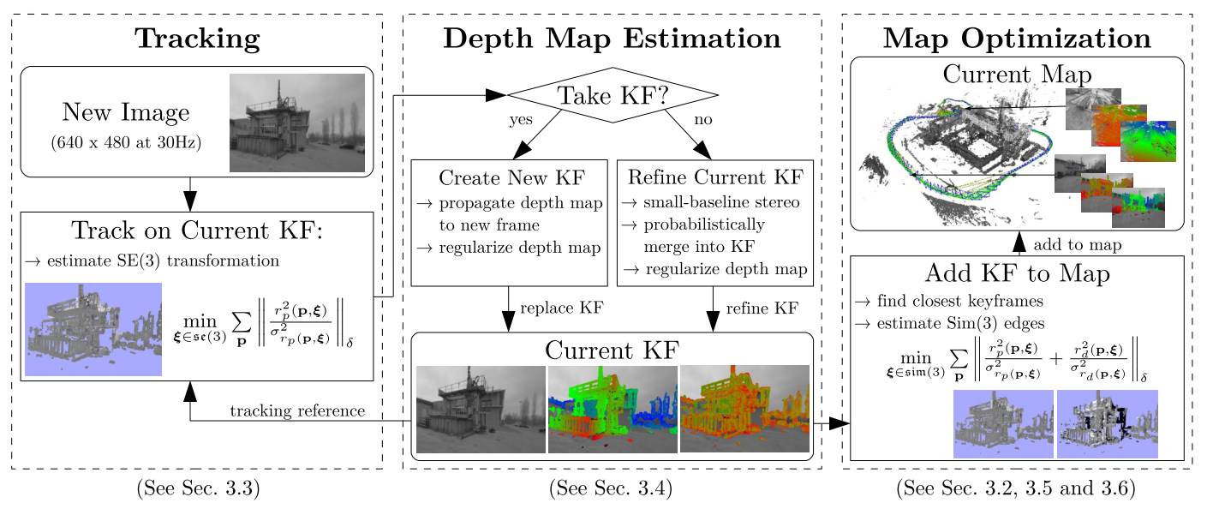
LSD-SLAM

Slide 6
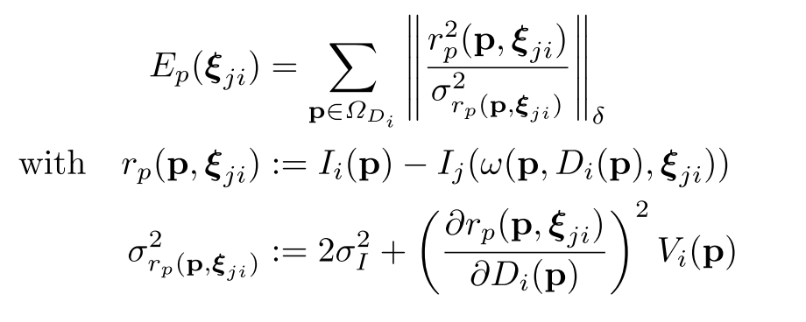
LSD-SLAM
Predict depth map for key frame (Random initial for the first)
Only at high intensity gradient (semi-dense)
Estimate Camera Pose to minimize

Slide 7

LSD-SLAM
If Pose Square greater than threshold, add a new key fram
For non-key frame, use them to optimize current key-frame
(Small baseline stereo match)
Semi-dense visual odometry for a monocular camera

Slide 8
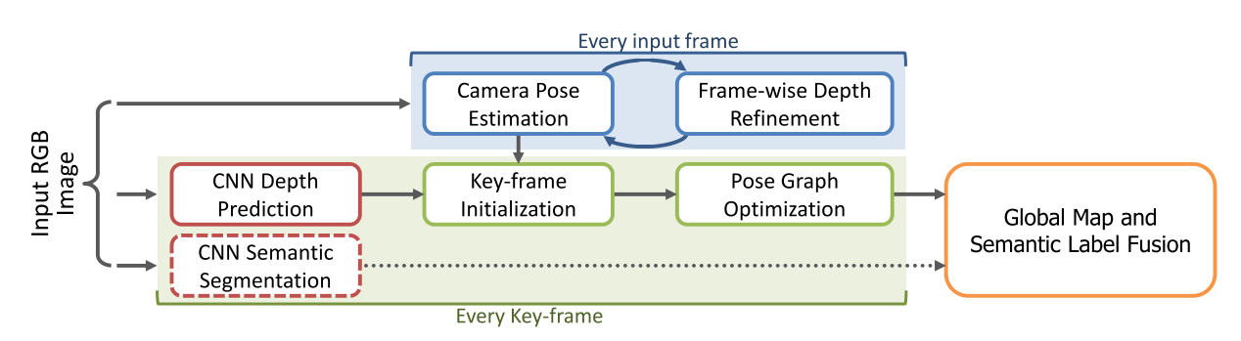
CNN-SLAM

Slide 9
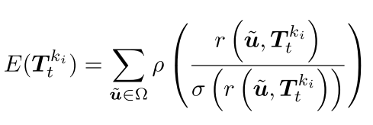
CNN-SLAM
Use CNN to predict depth for each key frame
(Deeper Depth Prediction with Fully Convolutional Residual Networks)
Dense depth map
Estimate Camera Pose to minimize

Slide 10
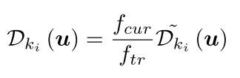
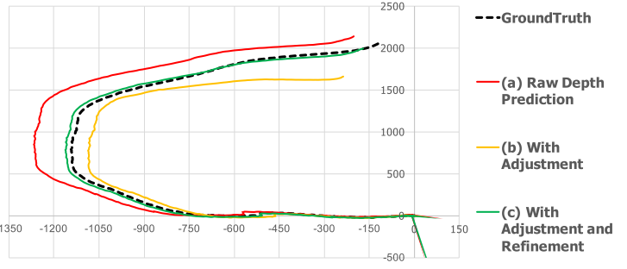
CNN-SLAM
For Camera fusion

Slide 11
CNN-SLAM
If Pose Square greater than threshold, add a new key fram
For non-key frame, use them to optimize current key-frame

Slide 12

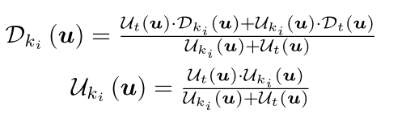
CNN-SLAM
Depth of current frame is predicted by small baseline match
For current key frame, calculate uncertainty map
Optimize current key frame depth by

Slide 13
https://www.youtube.com/watch?v=z_NJxbkQnBU

